Slide 1
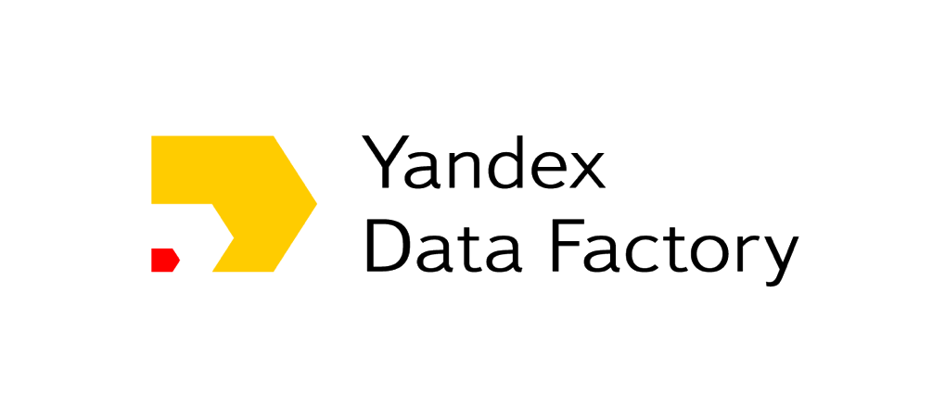
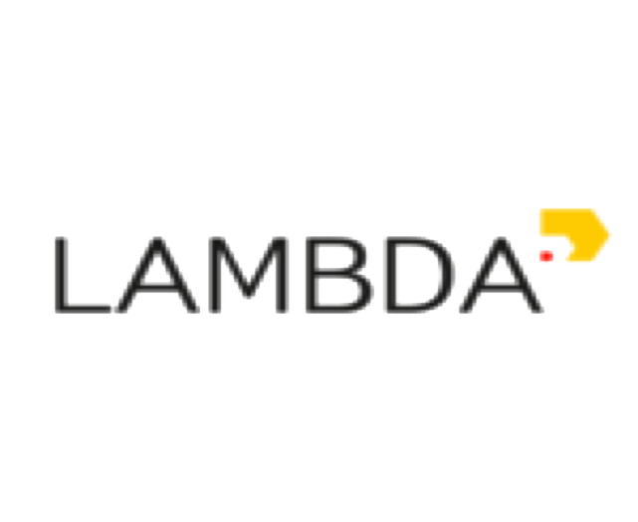
RL@Coursera week 2 Global optimality: discounted return

Slide 2
Explaining goals to agent through reward
Reward hypothesis (R.Sutton)
Goals and purposes can be thought of as the maximization of the expected value of the cumulative sum of a received scalar signal

Slide 3
Explaining goals to agent through reward
Reward hypothesis (R.Sutton)
Goals and purposes can be thought of as the maximization of the expected value of the cumulative sum of a received scalar signal
E.g.: reward in chess – value of taken opponent's piece
Сumulative reward is called return:

Slide 4
Explaining goals to agent through reward
Reward hypothesis (R.Sutton)
Goals and purposes can be thought of as the maximization of the expected value of the cumulative sum of a received scalar signal
E.g.: reward in chess – value of taken opponent's piece
Сumulative reward is called return:
end of episode
immediate reward

Slide 5
E.g.: data center non-stop cooling system
States – temperature measurements
Actions – different fans speed
R = 0 for exceeding temperature thresholds
R = +1 for each second system is cool
What could go wrong with such a design?

Slide 6
E.g.: data center non-stop cooling system
States – temperature measurements
Actions – different fans speed
R = 0 for exceeding temperature thresholds
R = +1 for each second system is cool
What could go wrong with such a design?
Infinite return for non optimal behavior!

Slide 7
E.g.: сleaning robot
States – dust sensors, air
Actions – cleaning / rest / conditioning on or off
R = 100 for long tedious floor cleaning task done
R = 1 for turning air conditioning on-off
Episode ends each day
What could go wrong with such a design?

Slide 8
E.g.: сleaning robot
States – dust sensors, air
Actions – cleaning / rest / conditioning on or off
R = 100 for long tedious floor cleaning task done
R = 1 for turning air conditioning on-off
Episode ends each day
What could go wrong with such a design?
R=1
R=100
Reward(air) < Reward(cleaning)
Time(air) << Time(cleaning)
Positive feedback loop!
Rest
Whole day
One second

Slide 9
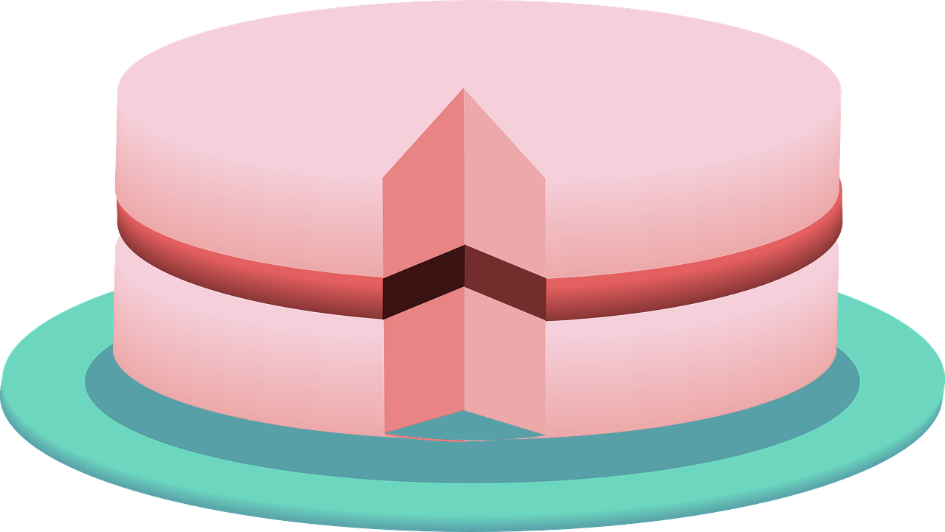
Reward discounting
Get rid of infinite sum by discounting
discount factor
The same cake compared to today’s one worth
times less tomorrow
times less the day after
tomorrow
will eat it day by day

Slide 10
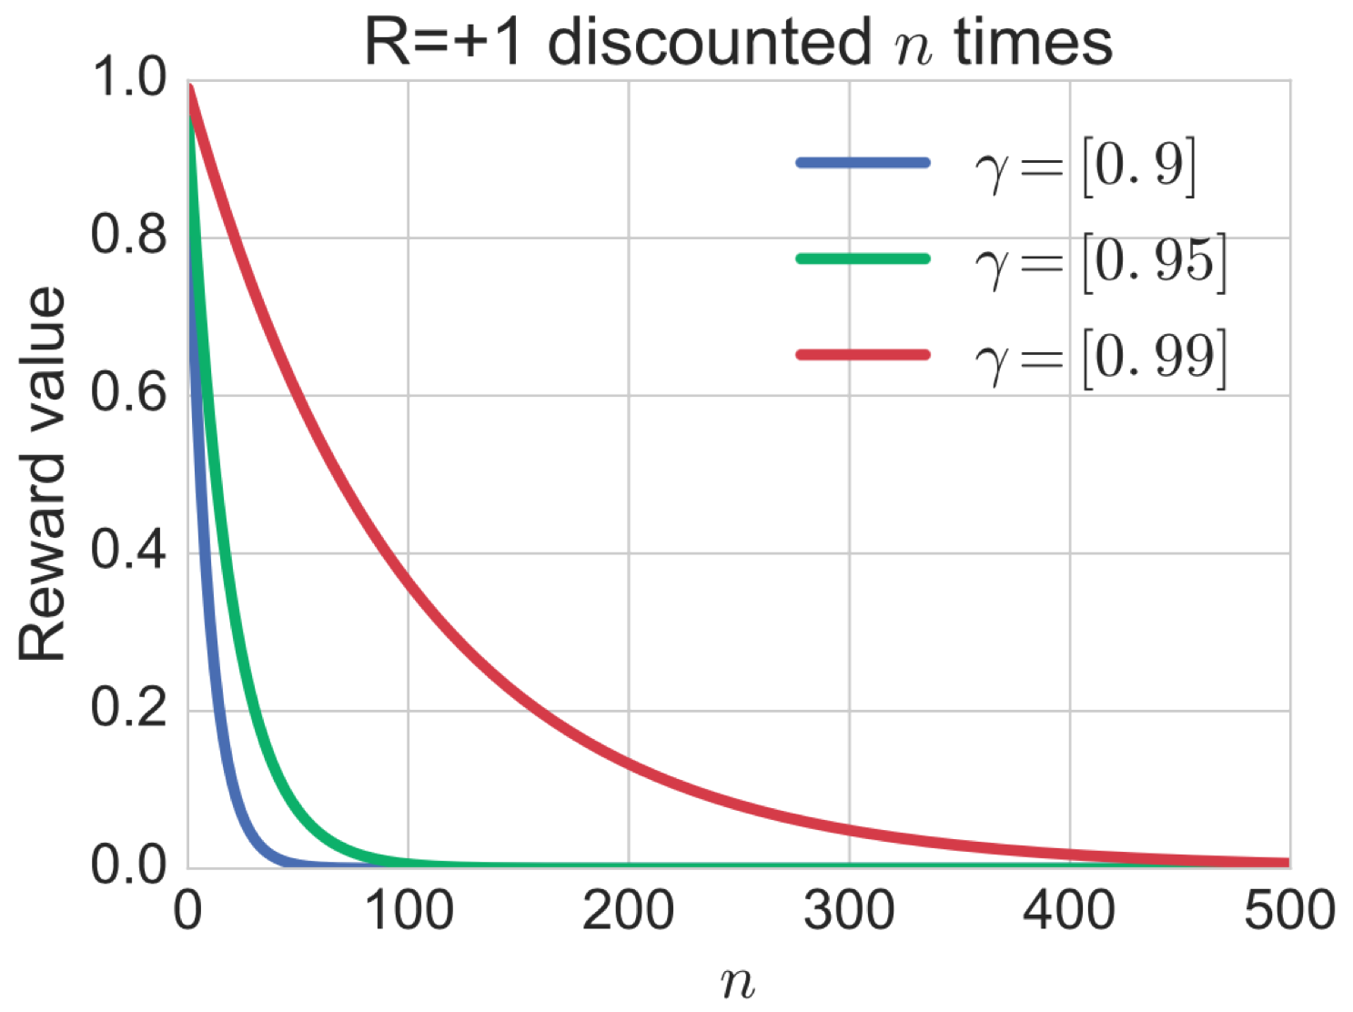
Discounting makes sums finite
Maximal return for R = +1
 | 0.9 | 0.95 | 0.99
 | 10 | 20 | 100
Any discounting changes optimization task and its solution!

Slide 11
Discounting is inherent to humans
Quasi-hyperbolic
Hyperbolic discounting
Laibson, D. (1997). Golden eggs and hyperbolic discounting.
The Quarterly Journal of Economics, 112(2), 443-478.

Slide 12
Discounting is inherent to humans
Quasi-hyperbolic
Hyperbolic discounting
Mathematical convenience
Remember this one!
We will need it later
Laibson, D. (1997). Golden eggs and hyperbolic discounting.
The Quarterly Journal of Economics, 112(2), 443-478.

Slide 13
Discounting: another view
Any action affects (1) immediate reward (2) next state

Slide 14
Discounting: another view
Any action affects (1) immediate reward (2) next state
But how long does this effect lasts?
Action indirectly affects future rewards
G is expected return under stationary end-of-effect model

Slide 15
Discounting: another view
Any action affects (1) immediate reward (2) next state
But how long does this effect last?
Action indirectly affects future rewards
“Effect continuation” probability
“End of effect” probability
G is expected return under stationary end-of-effect model

Slide 16
Reward design – don’t shift, reward for WHAT
E.g.: chess – value of taken opponent's piece
Problem: agent will not have a desire to win!
E.g.: сleaning robot, +100 (cleaning), +0.1 (on-off)
Problem: agent will not think about cleaning the floor!

Slide 17
Reward design – don’t shift, reward for WHAT
E.g.: chess – value of taken opponent's piece
Problem: agent will not have a desire to win!
E.g.: сleaning robot, +100 (cleaning), +0.1 (on-off)
Problem: agent will not think about cleaning the floor!
Take away: reward only for WHAT, but never for HOW
- 9
-1
S2
S1
S4
-1
-1
Start
End
S3

Slide 18
Reward design – don’t shift, reward for WHAT
E.g.: chess – value of taken opponent's piece
Problem: agent will not have a desire to win!
E.g.: сleaning robot, +100 (cleaning), +0.1 (on-off)
Problem: agent will not think about cleaning the floor!
Take away: reward only for WHAT, but never for HOW
- 9
-1
Take away: do not subtract mean from rewards
S2
S1
S4
-1
-1
Start
End
S3

Slide 19
Reward design – scaling, shaping
What transformations do not change an optimal policy?
Reward scaling – division by nonzero constant
May be useful in practiсe for approximate methods
Ng, A. Y., Harada, D., & Russell, S. (1999, June). Policy invariance under reward transformations: Theory and application to reward shaping. In ICML (Vol. 99, pp. 278-287).

Slide 20
Reward design – scaling, shaping
What transformations do not change an optimal policy?
Reward scaling – division by nonzero constant
May be useful in practiсe for approximate methods
Reward shaping – we could add to all rewards in MDP values of potential-based shaping function without changing an optimal policy:
Intuition: when no discounting adds as much as it
subtracts from the total return
definition
Ng, A. Y., Harada, D., & Russell, S. (1999, June). Policy invariance under reward transformations: Theory and application to reward shaping. In ICML (Vol. 99, pp. 278-287).

Slide 21
Global optimality: state and action value functions

Slide 22
How to find an optimal policy?
Dynamic programming!
Method to solve a complex problem by
breaking it into small pieces
until no more unsolved pieces
solve a single piece
reuse the solution to solve another piece
DP equations lies at the heart of RL
It is essential to deeply understand them.

Slide 23
How to find an optimal policy?
We know! Maximize cumulative discounted return!

Slide 24
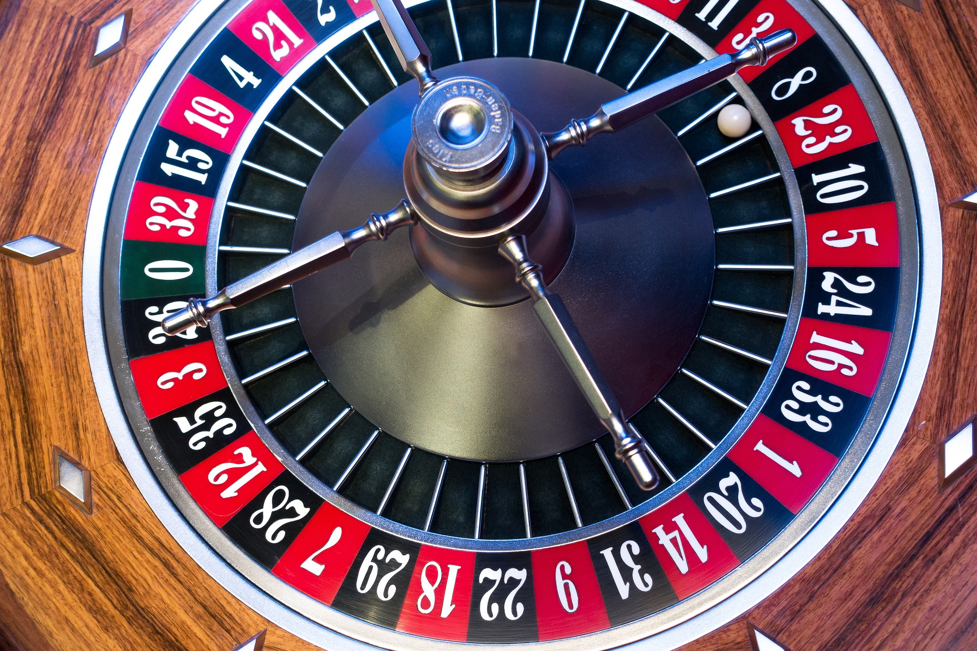
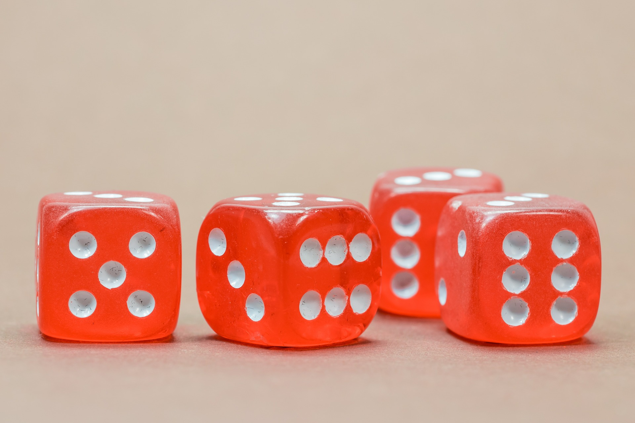
How to find an optimal policy?
We know! Maximize cumulative discounted return!
Let get rid of randomness by taking expectation!
But policy and / or environment could be random!

Slide 25
State-value function
is a return conditional on state:
Intuition: value of following policy from state

Slide 26
State-value function
is a return conditional on state:
stochasticity in policy & environment
Intuition: value of following policy from state

Slide 27
State-value function
is a return conditional on state:
stochasticity in policy & environment
Environment stochasticity
Policy stochasticity
Intuition: value of following policy from state

Slide 28
State-value function
is a return conditional on state:
stochasticity in policy & environment
Environment stochasticity
Policy stochasticity
By definition
Intuition: value of following policy from state

Slide 29
Bellman expectation equation for
Recursive definition of is an important concept in RL

Slide 30
Bellman expectation equation for
Recursive definition of is an important concept in RL
Backup diagram

Slide 31
Bellman expectation equation for
Recursive definition of is an important concept in RL
Backup diagram

Slide 32
Action-value function
Is expected return conditional on state and action:
Intuition: value of following policy after committing action a in state s

Slide 33
Action-value function
Is expected return conditional on state and action:
Intuition: value of following policy after committing action a in state s
No policy stochasticity at first step

Slide 34
Relations between and
We already know how to write in terms of
What about in terms of ?
So, we could now write in terms of !

Slide 35
Bellman expectation equation for
Backup diagram for

Slide 36
Bellman expectation equation for
Backup diagram for

Slide 37
What are we going to do with value function?
Bellman expectation equations → assess policy performance.
We know
what is return,
what is value- and action-value functions.
But we want to find optimal policy!
That is – to know optimal actions in each possible state.
But how to know which policy is better?
How to compare them?

Slide 38
Optimal policy is the one with the biggest
We could compare policies on the basis of
Best policy is better or equal to any other policy
In any finite MDP there is always at least one
deterministic optimal policy
Use optimal policy from
Commit action a, and afterwards use optimal policy

Slide 39
Bellman optimality equation for
Bellman expectation equation for
Bellman optimality equation for

Slide 40
Bellman optimality equation for
max
Bellman expectation equation for
Bellman optimality equation for

Slide 41
Bellman optimality equation for
max
Bellman expectation equation for
Bellman optimality equation for

Slide 42
Bellman optimality equation for
Bellman expectation equation for
Bellman optimality equation for

Slide 43
Bellman optimality equation for
max
max
Bellman expectation equation for
Bellman optimality equation for

Slide 44
Bellman optimality equation for
max
max
Bellman expectation equation for
Bellman optimality equation for

Slide 45
Well, that was tough. What’s next?
Now we are equipped with heavy artillery of
Bellman expectation equation for and
Bellman optimality equation for and
That will be our toolkit for finding optimal policy
using dynamic programming!

Slide 46
Generalized policy iteration: Policy: evaluation & improvement

Slide 47
Model-based setup with value-based approach
How to find optimal policy?
model & value based
Model-based setup – model of the world is known, i.e
for all is known
Value based approach
Build or estimate a value
Extract a policy from the value

Slide 48
Policy evaluation: motivation
If you can't measure it, you can't improve it. Peter Drucker
Policy evaluation is also called prediction problem:
predict value function for a particular policy.
Bellman expectation equation
is basically a system of linear equations where
# of unknowns = # of equations = # of states

Slide 49
Policy evaluation: algorithm
Input , the policy to be evaluated
Initialize an array , for all
Repeat
For each :
until (a small positive number)
Output
Bellman expectation
equation for

Slide 50
Policy improvement: an idea
Once we know what is for a particular policy
We could improve it by acting greedily w.r.t. !
This procedure is guaranteed to produce a better policy!

Slide 51
Policy improvement: an idea
Once we know what is for a particular policy
We could improve it by acting greedily w.r.t. !
This procedure is guaranteed to produce a better policy!
If for all states
then
meaning that

Slide 52
Policy improvement: convergence
If a new policy after improvement
is the same as the old one
then it is optimal!

Slide 53
Policy improvement: convergence
If a new policy after improvement
is the same as the old one
then it is optimal!
Bellman optimality equation

Slide 54
Determining an optimal policy from ,
If is known – how to recover an optimal policy?
If is known – how to recover an optimal policy?

Slide 55
Determining an optimal policy from ,
If is known – how to recover an optimal policy?
If is known – how to recover an optimal policy?
Unknown model dynamics → unable to recover
an optimal policy from

Slide 56
Precise evaluation is not needed

Slide 57
Value function
Greedy policy
 | 0.000 | 0.000 | 0.000
0.000 | 0.000 | 0.000 | 0.000
0.000 | 0.000 | 0.000
0 iter

Slide 58
Value function
Greedy policy
 | 0.000 | 0.000 | 0.000
0.000 | 0.000 | 0.000 | 0.000
0.000 | 0.000 | 0.000
0 iter
 | -7.598 | -4.986 | -3.127
-7.816 | -5.834 | -2.963 | 0.543
-6.115 | -4.186 | 0.332
5 iter
 | -13.827 | -13.289 | -11.318
-14.768 | -14.193 | -10.722 | -5.346
-16.111 | -13.454 | -6.059
9999 iter

Slide 59
Roadmap
Now we know what is
Policy evaluation (based on Bellman expectation eq)
Policy improvement (based on Bellman optimality eq)
The finishing touches:
how to combine them to obtain an optimal policy?

Slide 60
Generalized policy iteration: Policy and value iteration

Slide 61
The idea of policy and value iterations
Policy evaluation
Policy improvement

Slide 62
The idea of policy and value iterations
Generalized policy iteration
Evaluate given policy
Improve policy by acting greedily w.r.t. to it’s value function
Policy evaluation
Policy improvement

Slide 63
The idea of policy and value iterations
Generalized policy iteration
Evaluate given policy
Improve policy by acting greedily w.r.t. to it’s value function
Policy iteration
Evaluate policy until convergence (with some tolerance)
Improve policy
Value iteration
Evaluate policy only with single iteration
Improve policy
Policy evaluation
Policy improvement

Slide 64
Policy iteration: scheme
Initialize and arbitrarily for all
Perform policy evaluation (without internal initialization)
Policy Improvement
For each :
If , then
If , then stop and return and ;
else go to 2

Slide 65
Value iteration
Initialize array arbitrarily (e.g., for all )
Repeat
For each
until (a small positive number)
Output a deterministic policy, , such that
Bellman optimality
equation for

Slide 66
Value iteration (VI) vs. Policy iteration (PI)
VI is faster per cycle –
VI requires many cycles
PI is slower per cycle –
PI requires few cycles
No silver bullet → experiment with # of steps spent in policy evaluation phase to find the best algorithm for the task at hand

